Slide 1
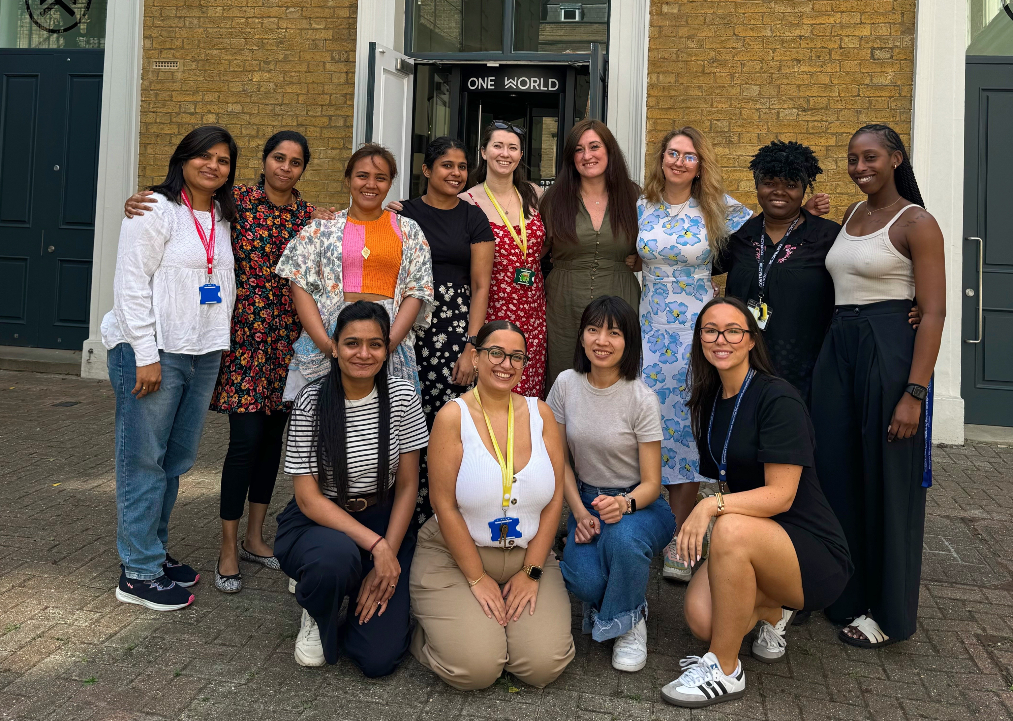
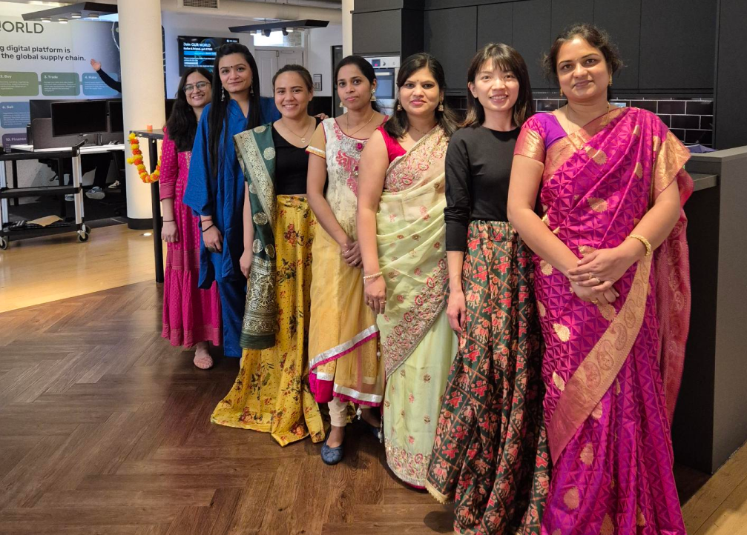
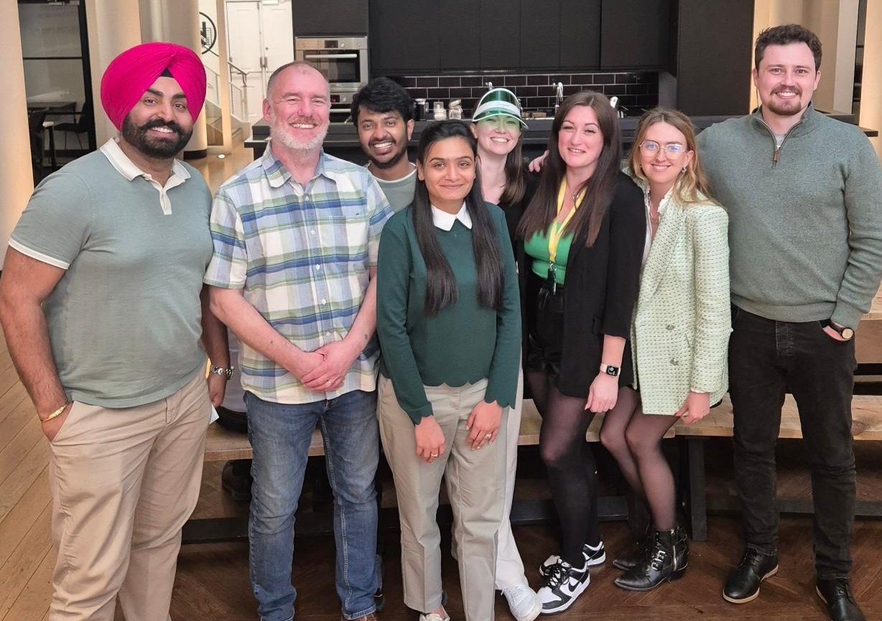
DE&I at One World
Women in Tech
Multicultural
Equity & Inclusion
Our One Worldian workforce comprises 35% women, exceeding the industry standard of 28%. At One World, we are deeply committed to gender diversity and inclusion. With one in three One Worldians being a woman, we are dedicated to attracting and retaining top female talent
We are proud to have employees from 21 countries, celebrating our cultural differences at One World. Our diversity drives innovation and creates a dynamic, inclusive environment. By bringing together varied perspectives and experiences, we foster a vibrant community where everyone thrives. Embracing global diversity enables us to push boundaries, think creatively, and achieve excellence.
At One World, we encourage diverse thinking and welcome differences, recognising that varied perspectives enhance creativity and problem-solving. Our commitment to equality drives us to create an inclusive environment where all team members can succeed. By fostering mutual respect and understanding, we empower our employees to collaborate and innovate effectively.

